Slide 1

Project Phase 2: Review 4
PJ22CS13: IoT BASED SMART CHAIR USING RASPBERRY PI
By
DHANUSH B - 1VI19CS026
GOWTHAM V- 1VI19CS032
HAFSA MOHAMMADI-1VI19CS034
KOMAL BHAT-1VI19CS046
Under the Guidance of
Dr Kantharaju H C
Associate Professor

Slide 2
BIRD VIEW
IoT BASED SMART CHAIR USING RASPBERRY PI
2022 - 23
Introduction
Abstract
Literature Survey
Comparative analysis of the survey
Problem Statement
System Specification
Design Methodology
Module Description
Test Cases
Project Demonstration
Project Outcome
Applications
References
1

Slide 3
INTRODUCTION
IoT BASED SMART CHAIR USING RASPBERRY PI
2022 - 23
The complications of poor posture include back pain, spinal dysfunction, joint degeneration, rounded shoulders and a potbelly.
Considering the posture problem whether it's the result of sitting at a desk all day, looking down at a smartphone, or lounging on a couch, poor posture is dogging people of all ages.
It's a common and an important health problem, and it can lead to neck pain, back problems, and other aggravating conditions," says Meghan Markowski, a physical therapist at Harvard-affiliated Brigham and Women's Hospital.
Turning a normal chair into a smart chair that will continuously detect your sitting posture and sends notification for not sitting correctly.
2

Slide 4
ABSTRACT
IoT BASED SMART CHAIR USING RASPBERRY PI
2022 - 23
This project helps us to assess the posture of a seated person in real-time and improve sitting posture. We use an IoT system with sensors, processing ability and software with the chair and make it smart so that it can help humans to maintain good posture and maintain good healthy habits ultimately. Turning a normal chair into a smart chair with raspberry pi that will continuously detect your sitting posture and sends an notification for wrong postures. Two flex sensors will be fitted onto the backrest of the chair to detect the inclination of the chair. The backrest sensor will detect if the person is sitting straight or not. The humidity and temperature sensor module on the cushion of the seat will detect the temperature and pressure of the user. The goal of this project is to maintain proper posture for improved health and longevity.
04/05/2023
3

Slide 5
LITERATURE SURVEY - 1
IoT BASED SMART CHAIR USING RASPBERRY PI
2022 - 23
Title : A Smart System for Sitting Posture Detection Based on Force Sensors and Mobile Application[2020]
Author: Slavomir Matuska , Martin Paralic, and Robert Hudec
Methodology : Sitting posture detection based on force sensors and mobile applications. Six flexible force sensors, two on the backrest and four on the bottom seat.
Advantage: User can see the information about sitting posture correctness and other pieces of detailed information in the mobile application.
Limitation: Implementing the force sensors into the chair. For Apple users, developing an application for IOS or use of the multiplatform framework will become difficult to implement.
4

Slide 6
LITERATURE SURVEY - 2
IoT BASED SMART CHAIR USING RASPBERRY PI
2022 - 23
Title : A Sitting Posture Monitoring Instrument to Assess Different Levels of Cognitive Engagement[2019]
Author: Daniele Bibbo, Marco Carli, Silvia Conforto and Federica Battisti
Methodology : A set of textile pressure sensors both on the backrest and on the seat of the chair.
Advantage: Use of simple textile sensors and of low-cost electronic equipment that can be easily embedded in the chair structure.
Limitation: The selected sensors were only used as a measure to maximize the reliability of the results.
5

Slide 7
LITERATURE SURVEY - 3
IoT BASED SMART CHAIR USING RASPBERRY PI
2022 - 23
Title : Design and Implementation of Smart IoT Chair for Better Health and Productive Work [2022]
Author: Timon Padberg, Sojat Sebgaze, Rim Zakar, and Rajeev Kanth
Methodology : The microcontroller used here is the Joy-it Mega2560R3 (Joy-IT), which is similar to the Arduino Mega.
Advantage: Cheap and straightforward electronic materials.
Limitation: The notifications for the user is not implemented.
6

Slide 8
LITERATURE SURVEY - 4
IoT BASED SMART CHAIR USING RASPBERRY PI
2022 - 23
Title : An IoT and Cloud Enabled Smart Chair for Detection and Notification of Wrong Seating Posture[2022]
Author: Brijesh Kundaliya, Smit Patel, Jaanvi Patel, Parv Barot, S. K. Hadia
Methodology : Force sensor and flex sensor is used to detect the wrong sitting posture
Advantage: Computation and data storage has been done on the server rather than locally on user’s device which reduces power consumption and memory consumption.
Limitation: If the person is sitting at the edge of the chair then it is impossible to get reading from the sensor.
7

Slide 9
LITERATURE SURVEY - 5
IoT BASED SMART CHAIR USING RASPBERRY PI
2022 - 23
Title : Smart posture detector using IoT [2021]
Author: Vidhya. B, Abdul Hayum. A, Saranya. G, Aarthi. M, Aishwarya. V, Dhanashree. K
Methodology : Uses a mems sensor to detect the posture and notifies the user about the same by mentioning the status of it as a bad or worse posture with the help of a voiceover.
Advantage: Along with the detection on a chair, they have made it wearable by which the kit can be carried anywhere and be detected where it’s not necessary that the user should be in a seating position.
8

Slide 10
LITERATURE SURVEY - 6
IoT BASED SMART CHAIR USING RASPBERRY PI
2022 - 23
Title : Development of a Smart Chair Sensors System and Classification of Sitting Postures with Deep Learning Algorithms [2022]
Author: Taraneh Aminosharieh Najafi, Antonio Abramo, Kyandoghere Kyamakya and Antonio Affanni
Methodology : The system consists of eight pressure sensors placed on the chair’s sitting cushion and the backrest. The performance of the designed sensors system was evaluated with seven deep learning models
Advantage: low number of deployed pressure sensors, the adopted design is easily applicable to many types of chair and armchair. no cables are required
Limitation: Parameters like emotion, behavior and activity identification were not considered
9

Slide 11
LITERATURE SURVEY - 7
IoT BASED SMART CHAIR USING RASPBERRY PI
2022 - 23
Title : Smart Chair for Monitoring of Sitting Behavior [2017]
Author: Meng jie Huang, Ian Gibson, and Rui Yang
Methodology : The sensor array was composed of two layers of polyester films, with the horizontal silver electrode strips and the other vertical on one layer.
Advantage: With the optimal settings of neural network, the overall classification accuracy of eight sitting postures reached 92.2%.
Limitation: Hip location on the pressure pattern recognition was not considered to improve the classification rate of sitting postures.
10

Slide 12
LITERATURE SURVEY - 8
IoT BASED SMART CHAIR USING RASPBERRY PI
2022 - 23
Title : Healthy sitting behavior enhancement using a smart chair system [2021]
Author: Ana Castillo-Martinez, Jose-Maria Gutierrez-Martinez, Roberto Barchino, Juan José Córdoba Zamora, Sergio de la Mata Moratilla
Methodology : A DSR methodology has been followed, creating a prototype that evolves over time.
Advantage: Ability to warn of possible bad postures means that the project could be useful in other areas such as offices to look after the posture health of workers.
Limitation: It was possible to check how in a 5% of times the incorrect evaluations was performed because of noise in the sensing procedure.
11

Slide 13
LITERATURE SURVEY - 9
IoT BASED SMART CHAIR USING RASPBERRY PI
2022 - 23
Title : Design and Analytics of Smart Posture Monitoring System [2021]
Author: Chaitanya Kumar A, and V G Sridhar
Methodology : In this paper they have adopted two forms of feedback to alert the user of the sitting position, Visual feedback and Vibrotactile feedback. The systems deployed uses a one- to-one communication system, through which data can be viewed only in a single device.
Advantage: It is possible to visualize data in a variety of gauges and charts, anywhere around the world. represents the dashboard on the Thingsboard API to measure the body vitals in this regard
Limitation: Voice assistive functionalities can be given
12

Slide 14
LITERATURE SURVEY - 10
IoT BASED SMART CHAIR USING RASPBERRY PI
2022 - 23
Title : Smart Office Chairs with Sensors for Detecting Sitting Positions and Sitting Habits: A Review[2022]
Author: Zoran Vlaović, Marko Jaković, Danijela Domljan
Methodology :Three different machine learning algorithms were employed: random forest (RF), extremely randomized trees (ERTs), and support vector machine (SVM).
Advantage: System monitors how people sit, gathers and processes data, and displays it in real time has the best outcomes since it directly influences the user's decision to modify or maintain their position.
Limitation: Problems could be related to the acceptance of such built-in monitors by users, mostly due to the risk of invading privacy. There are also possible dangers of malicious intrusions into systems (hacking).
13

Slide 15
LITERATURE SURVEY - 11
IoT BASED SMART CHAIR USING RASPBERRY PI
2022 - 23
Title : Design of a Low Cost Smart Chair for Telemedicine and IoT based Health Monitoring [2016]
Author: G. R. D. Ganesh, K. Jaidurgamohan, Vakada Srinu, Chandrakanth R. Kancharla, Susurla V. S. Suresh
Methodology : The subject is to be seated in a relaxed posture during the acquisition of physiological signals from various sensors attached to his/her body. The raw signals from the sensors are processed digitally by an onboard microcontroller and analyzed for any common abnormalities in the health parameters of the subject.
Advantage: Low cost affordable solution for IoT based telemedicine system, as compared to existing systems.
Limitation: A custom made web server will eliminate the constraint of creating an API key for each subject.
14

Slide 16
LITERATURE SURVEY - 12
IoT BASED SMART CHAIR USING RASPBERRY PI
2022 - 23
Title : A Smart Sitting Chair for Office Employees [2022]
Author: R. Gayathri , B. Pavithra, S. Prabhavathi, G. Sakthi
Methodology : The project identifies four different incorrect sitting postures such as of a person and detects who works for a long duration and alerts them by sending message through mobile phones connected via GSM module. If the person continues to sit for a long time in the wrong position, the position motor which is connected using motor driver in the system will adjust the chair to the original position.
Advantage: Developed a smart sitting chair with low power consumption and low computing overhead.
Limitation: System works continuously for 9 hours ,after that system automatically stops.
15

Slide 17
COMPARATIVE ANALYSIS
IoT BASED SMART CHAIR USING RASPBERRY PI
2022 - 23
Reference | Algorithm/ Technique | Platform used | Performance Metrics | Advantage | Drawback
[1] | Force sensors | Arduino | Six single-zone force sensing resistors Flex402 are used to measure the force. | View information about posture and other info on the mobile application | Implementing force sensors, developing app for IOS users
[2] | Textile pressure sensors | An embedded platform based on a microcontroller unit (MCU) | ATSs pressure trend over time. If the signal is under the threshold, the sensor is pressed. | This system can be used in situations with different level of engagement, different levels of stress. | Not taken the dynamic parameters of the posture
[3] | Load sensors, amplifier, combinator | Arduino Mega microcontroller | The load sensors detect weight, and the timer starts to count sitting time | Cheap and straightforward electronic materials. | Notification to users not implemented
16

Slide 18
COMPARATIVE ANALYSIS
IoT BASED SMART CHAIR USING RASPBERRY PI
2022 - 23
Reference | Algorithm/ Technique | Platform used | Performance Metrics | Advantage | Drawback
[4] | Force sensor, flex sensor | ESP 32 Microcontroller | Pressure sensor for recording the data when a person sits on the chair. | Provides seamless connectivity and a notification mechanism. It also maintains the database on the cloud | If the person is sitting at the edge of the chair then it is impossible to get reading from the sensor.
[5] | IR Sensor, MEMS Sensor | Arduino | MEMS sensor to detect the pressure, IR sensor to detect the posture | Along with the detection on a chair, they have made it wearable by which the kit can be carried anywhere
[6] | SVM, PCA, KNN, ANN, Optimization algorithm, EMN | Printed Circuit Board, Arduino | Accuracy of 91.68% by an echo memory network model | Number of pressure sensors are less, no cables required | Only classifies posture as proper or not
17

Slide 19
COMPARATIVE ANALYSIS
IoT BASED SMART CHAIR USING RASPBERRY PI
2022 - 23
Reference | Algorithm/ Technique | Platform used | Performance Metrics | Advantage | Drawback
[7] | ANN | Arduino and Jupyter Notebook | The pressure data of 5 trials for each subject were acquired after experiments. | Accuracy of eight sitting postures reached 92.2%. | Hip location on the pressure pattern recognition was not considered
[8] | IoT, AI Techniques | DSR method, Arduino | An IoT projects with 5 layers. | Ability to warn of possible bad postures which is useful for office workers | 5% of noise in the sensing procedure
[9] | Custom designed sensors, pressure and tilt sensors | MATLAB software for the training of neural networks. | Uneven pressures are sensed, a notification is sent to the authorized users. | Sensors placed on the chair detects the values in the form of frequencies | Voice assistive functionalities can be given
18

Slide 20
COMPARATIVE ANALYSIS
IoT BASED SMART CHAIR USING RASPBERRY PI
2022 - 23
Reference | Algorithm/ Technique | Platform used | Performance Metrics | Advantage | Drawback
[10] | Random forest (RF), extremely randomized trees (ERTs), and support vector machine (SVM). | Arduino | Not specified | Discusses a variety of sensors | Risk of invading privacy
[11]​ | IC MAX30100, Transducer MP3V5050, Transducer CZL635, IC LMT70​ | Arduino with Atmega2560 microcontroller​ | The preprocessed analog signals are sampled using the ADC of the microcontroller and stored in arrays using digital filters.​ | A custom application which sends the snapshot of the displayed data and a text file via a MMS or EMAIL to a remote physician. ​ | Having a keypad on smart chair allows the user to enter his/her name and create a database in the web server for his/her health records​
[12]​ | Three sensors connected to microcontroller such as Pressure sensor, Flex sensor and Accelerometer.​ | Arduino UNO microcontroller.​ | Components are operated by programming the microcontroller using Embedded C.​ | Developed a smart sitting chair with low power consumption and low computing overhead.​ | System works continuously for 9 hours ,after that system automatically stops.​ ​
19

Slide 21
PROBLEM STATEMENT
IoT BASED SMART CHAIR USING RASPBERRY PI
2022 - 23
Nowadays most of us sit and work for long hours. Adults working in offices sit for a long time and get glued to their work and often forget the correct posture in which they should sit.
Slouching/Poor posture could cause back pain, spinal dysfunction, joint degeneration, rounded shoulders, etc. as studied by Australian Physiotherapy Association.
The health issues faced due to improper posture and prolonged sitting is a huge problem.
We can use an IoT system with sensors, processing ability and software with the chair and make it smart so that it can help humans to maintain good posture and maintain good healthy habits ultimately.
20

Slide 22
SYSTEM SPECIFICATION
2022 - 23
IoT BASED SMART CHAIR USING RASPBERRY PI
Hardware requirements
CPU : x86_64 CPU architecture, Intel or AMD processor
RAM : 8 GB RAM or more
Display Resolution : 1920 * 1080 screen resolution
Raspberry pi 4 model b
Circuit components : Flex sensor, DHT11, ADS1115, jumper wires, breadboard.
Software requirements
Raspbian OS
Python 3.10.1
MySQL
Java
Android studio
NetBeans IDE
21

Slide 23
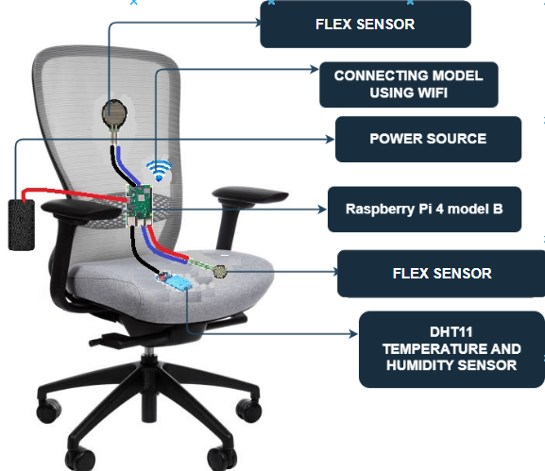
DESIGN METHODOLOGY
2022 - 23
IoT BASED SMART CHAIR USING RASPBERRY PI
System Architecture
All Raspberry Pi models have on-board Wi-Fi. We can configure Wi-Fi on our Raspberry Pi with both Raspberry Pi OS desktop and server. Power source will provide power supply to our raspberry pi module. A DHT11 Humidity and Temperature Sensor Module is placed on the cushion with the Flex Sensor. 2 Flex sensors will be on the chair to measure force.
22

Slide 24
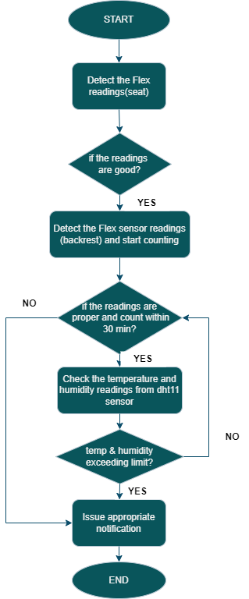
DESIGN METHODOLOGY
2022 - 23
IoT BASED SMART CHAIR USING RASPBERRY PI
Data flow diagram
Figure explains how the proposed system works is it detects the Flex sensor readings, this indicates the user sitting on chair. Once the user sits, Flex sensor readings are obtained to check if the person sitting in proper position for posture detection and start counting for 30 minutes. If the counting exceeds more than specified time, it will give appropriate message to the user. Meanwhile temperature and humidity reading are collected from DHT11 sensor constantly.
23

Slide 25
MODULE DESCRIPTION
2022 - 23
IoT BASED SMART CHAIR USING RASPBERRY PI
Module 1: Measuring the force readings from Flex sensors
Flex sensors in the smart chair are used to measure the user's posture while sitting. When the user sits in the chair, the flex sensors on the back and beneath the seat bend and measure the amount of flexing. This information is then sent to the Raspberry Pi, which processes it and determines the user's posture. Based on this data, the smart chair can provide the user with alerts and feedback to encourage good sitting posture and reduce the risk of discomfort or injury caused by poor posture.
User sits on the chair
Measures the pressure
Send readings to Raspberry Pi
Determine the user posture
24

Slide 26
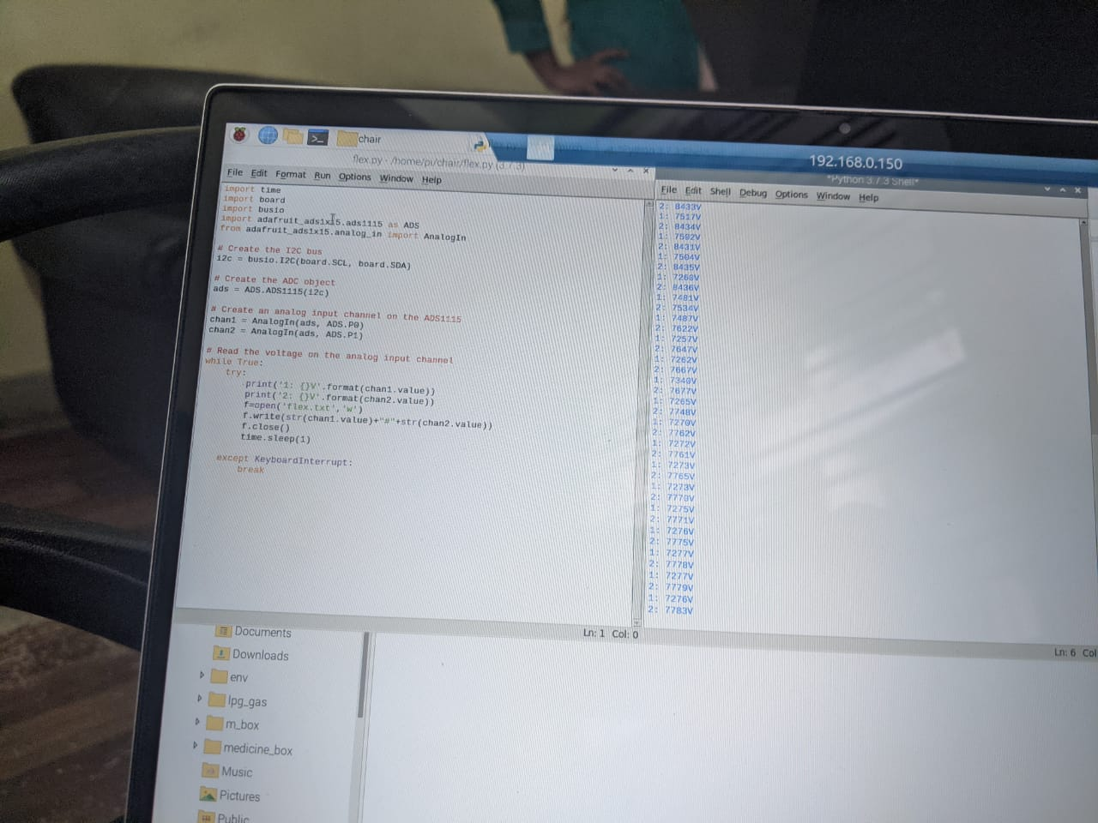
MODULE DESCRIPTION
2022 - 23
IoT BASED SMART CHAIR USING RASPBERRY PI
def flex():
flexData="sensor 1: "+str(chan1.value)+" Sensor 2 : “
+str(chan2.value)+" Sensor 3: "+str(chan3.value)
print(flexData)
return str(chan1.value)+"##"+str(chan2.value)
+"##"+str(chan3.value)
25

Slide 27
MODULE DESCRIPTION
2022 - 23
IoT BASED SMART CHAIR USING RASPBERRY PI
Module 2: Measuring temperature and humidity
The DHT11 Temperature and humidity sensor is placed on the chair. This will continuously detect the human temperature and if humidity is present, that also is sensed by this sensor. The temperature range of DHT11 is from 0 to 50 degree Celsius with a 2-degree accuracy. Humidity range of this sensor is from 20 to 80% with 5% accuracy.
User sits on the chair
Measures the humidity and temperature
Send readings to Raspberry Pi
Determine the user habits
26

Slide 28
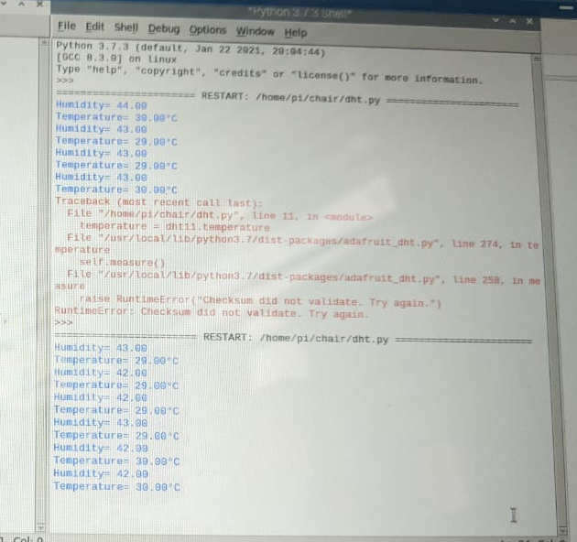
MODULE DESCRIPTION
2022 - 23
IoT BASED SMART CHAIR USING RASPBERRY PI
def temp():
dht11 = adafruit_dht.DHT11(SENSOR_PIN,
use_pulseio=False)
temperature = dht11.temperature
humidity = dht11.humidity
data="Temp: "+str(temperature)+" Humi: "+str(humidity)
print(data)
return str(temperature)+"##"+str(humidity)
27

Slide 29
MODULE DESCRIPTION
2022 - 23
IoT BASED SMART CHAIR USING RASPBERRY PI
Module 3: Self-monitoring through an application
Notifications via mobile applications are a common way for smart chairs to alert users about incorrect posture. When a flex sensor attached to the chair detects that the user's posture is incorrect, it sends the data to a microcontroller, which sends a notification to the user's mobile device. If the user has been sitting for more than 30 minutes, a notification is sent to them. The user can then adjust their posture and receive real-time feedback on how well they are doing. Integrating a mobile app with a smart chair improves functionality and usability.
28

Slide 30
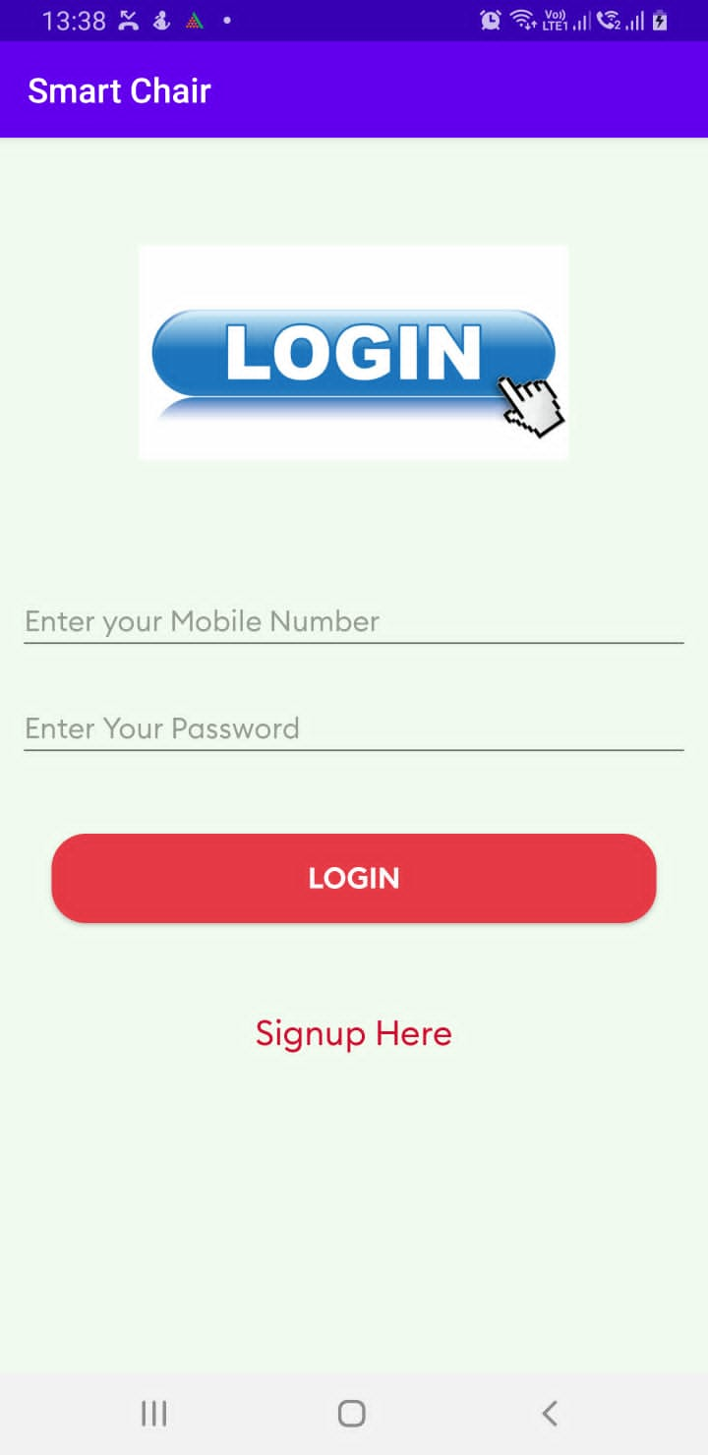

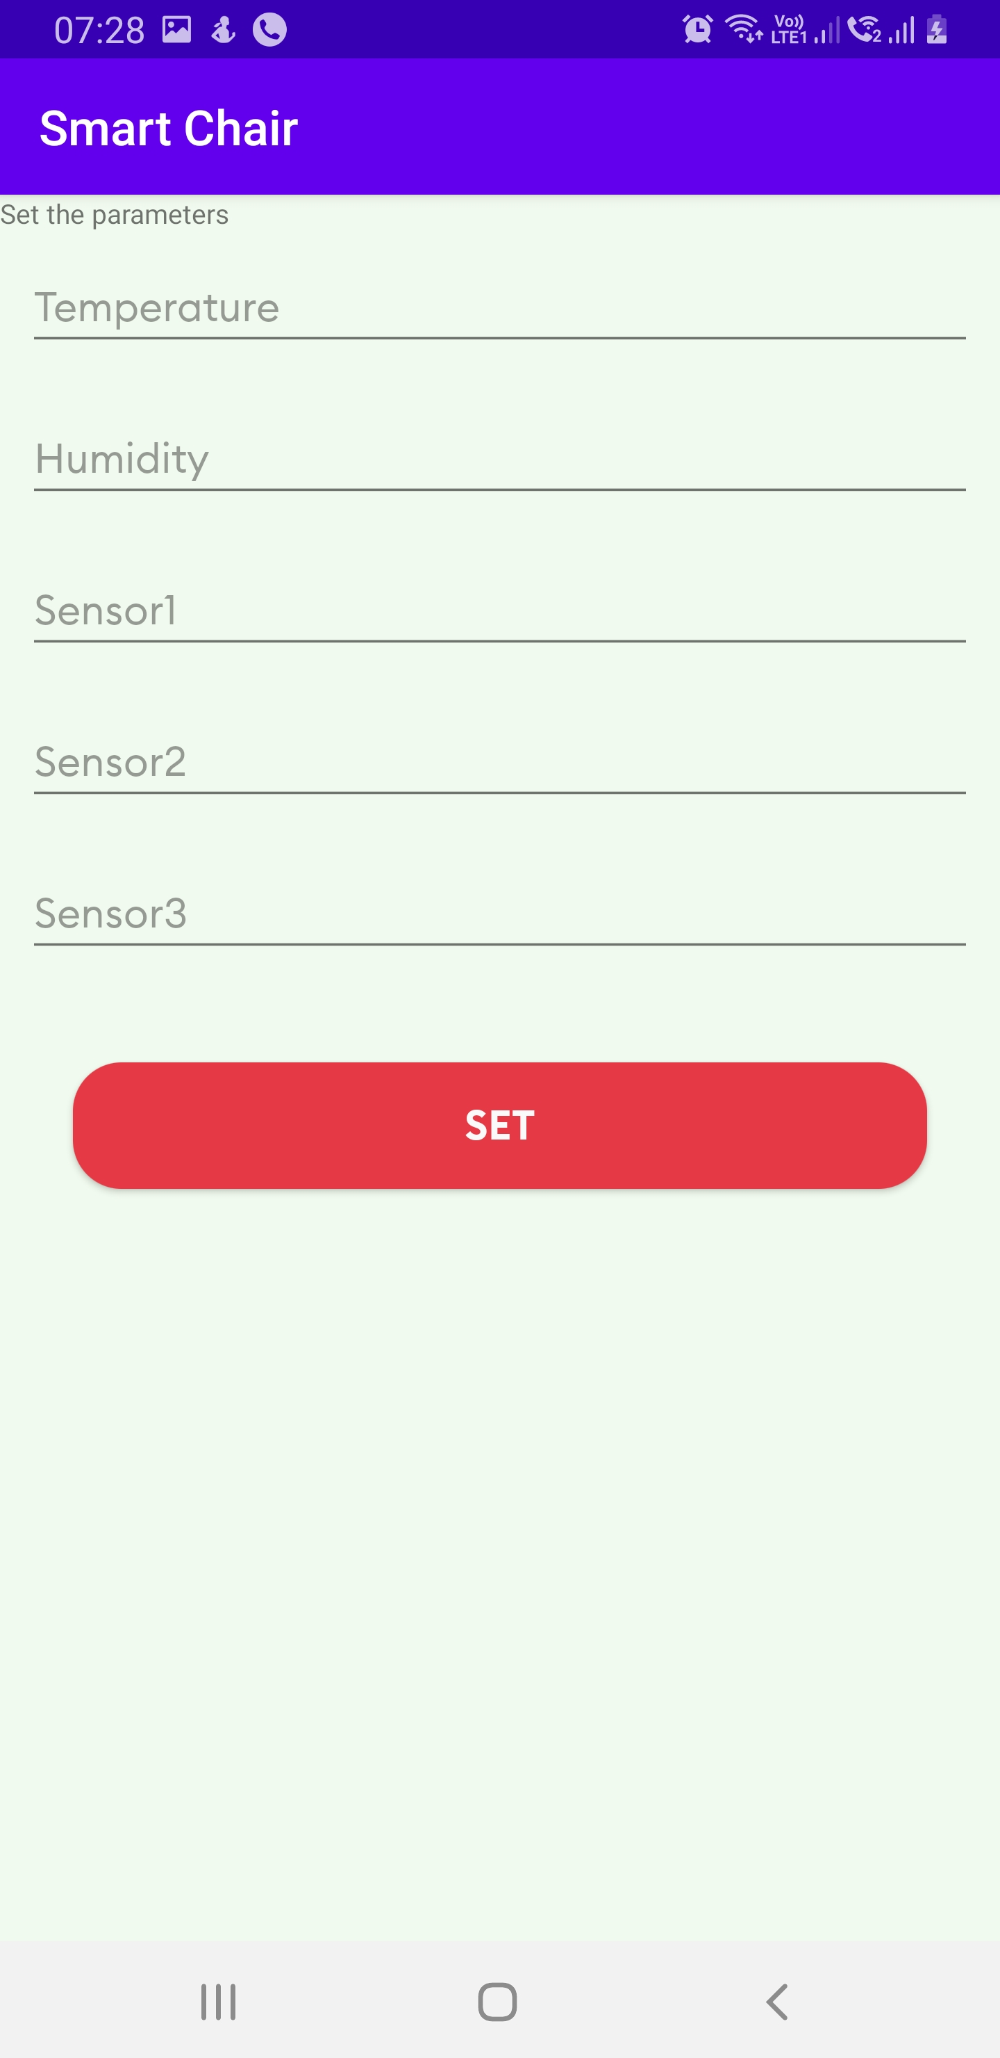
MODULE DESCRIPTION
2022 - 23
IoT BASED SMART CHAIR USING RASPBERRY PI
Login Page
Splash Screen
User Settings
29

Slide 31
SYSTEM TESTING
2022 - 23
IoT BASED SMART CHAIR USING RASPBERRY PI
Test Case ID. | Input Description | Expected Output | Actual Output | Remarks
1 | Data Collection | The sensor data to be collected from raspberry pi | Same as expected | Pass
2 | Transfer data | The collected data to be sent to the server using HTTP protocol | Same as expected | Pass
3 | Signup | User should be able to sign up using the mobile application | Same as expected | Pass
4 | Login | User should be able to login using the mobile application | Same as expected | Pass
5 | Monitor user | Server side application should be able to monitor the user's sitting pattern | Same as expected | Pass
6 | Send alert | Server side application should be able to send message to the user's mobile app | Partial | Pass
30

Slide 32
PROJECT DEMONSTRATION
2022 - 23
IoT BASED SMART CHAIR USING RASPBERRY PI
The smart chair allows the user to sit on it, and the posture of the user is measured by flex sensors located on the back and below the chair.
The temperature and humidity of the user is measured by the DHT11 sensor located on the cushion.
The data collected by these sensors is sent to the server, which stores the data.
The application displays the sitting time, good posture, bad posture, graphs and provides feedback to the user, sends notification after 30 minutes of sitting.
31

Slide 33
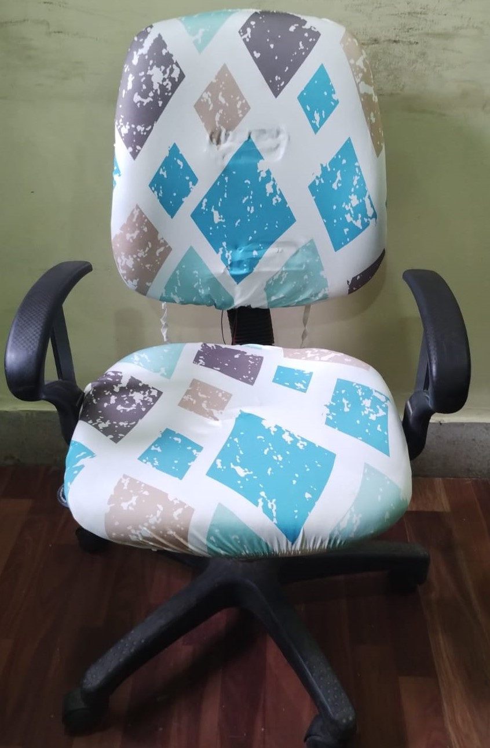
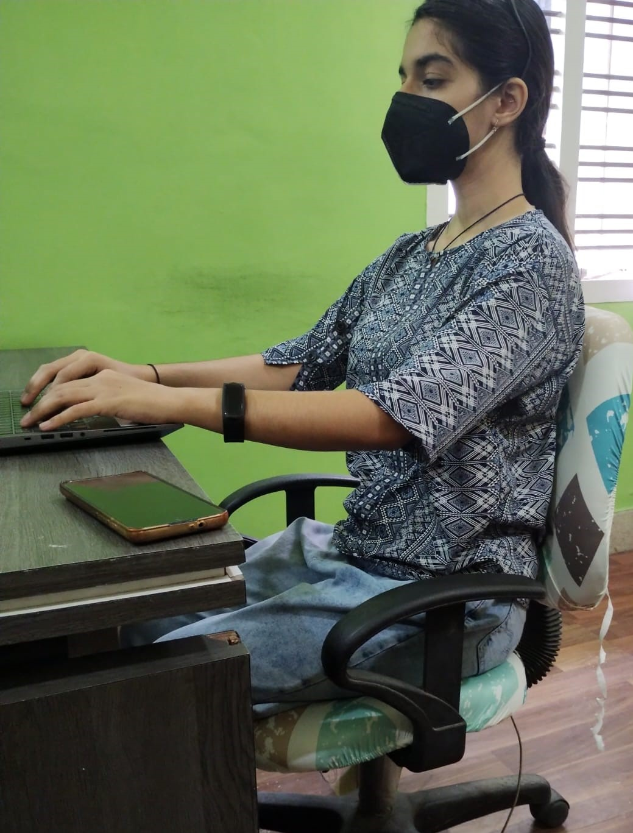
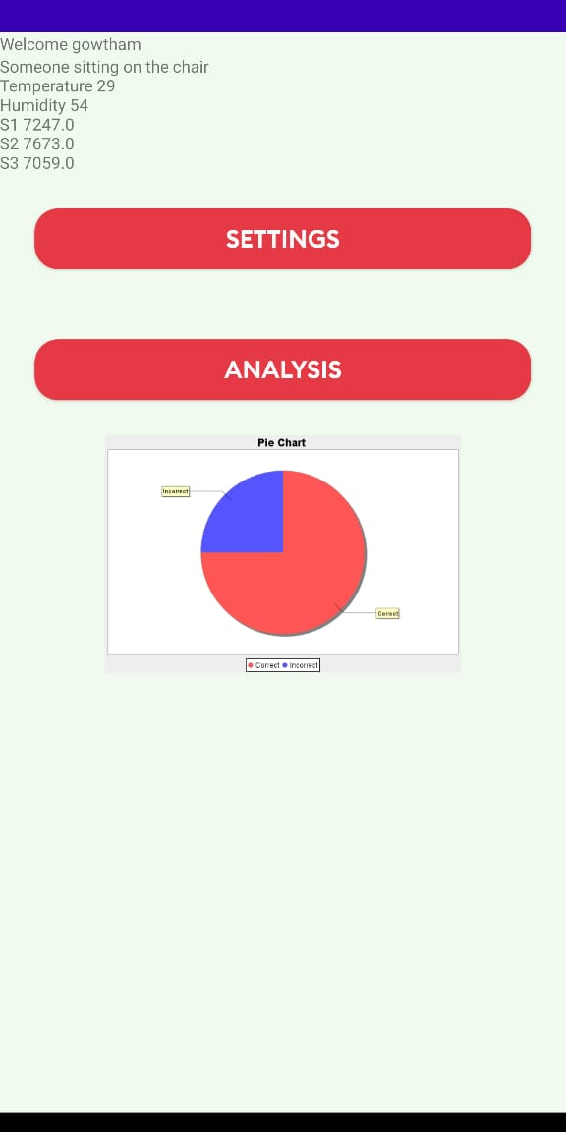
OUTCOME
2022 - 23
IoT BASED SMART CHAIR USING RASPBERRY PI
The developed smart chair system will be able to monitor the sitting behavior of human body and help in advocating better sitting habits of users.
Home Page Of Application
Smart Chair
Correct Posture
32

Slide 34
APPLICATIONS
2022 - 23
IoT BASED SMART CHAIR USING RASPBERRY PI
Office workers: Many people who work in offices sit for long periods of time, which can lead to poor posture and related health problems. A smart chair that corrects posture can help office workers maintain good posture throughout the day, reducing the risk of back pain and other issues.
Students: Students who spend long hours studying or working on assignments can also benefit from a smart chair that helps them maintain good posture. This can improve their comfort and concentration, which in turn can lead to better academic performance.
33

Slide 35
REFERENCES
IoT BASED SMART CHAIR USING RASPBERRY PI
2022 - 23
RESEARCH PAPERS:
Speakman, J.R. An evolutionary perspective on sedentary behavior. Bio Essays 2020, 42, 190015
Prentice-Dunn, H.; Prentice-Dunn, S. Physical activity, sedentary behavior, and childhood obesity:
A review of cross sectional studies. Psychol. Health Med. 2012, 17, 255–273
Schrempf, A.; Schossleitner, G.; Minarik, T.; Haller, M.; Gross, S. PostureCare—Towards a novel system for posture monitoring and guidance. IFAC Proc. Vol. 2011, 44, 593–598
M. Huang, I. Gibson, and R. Yang, “Smart chair for monitoring of sitting behavior”. In DesTech Proceedings of the International Conference on Design and Technology, 2017, 274–280
Speakman, J.R. An evolutionary perspective on sedentary behavior. BioEssays 2020, 42, 190
\
34

Slide 36
REFERENCES
IoT BASED SMART CHAIR USING RASPBERRY PI
2022 - 23
Tan, H.; Slivovsky, L.; Pentland, A. A sensing chair using pressure distribution sensors. IEEE/ASME Trans. Mechatron. 2001, 6, 261–268
Wang, J.; Hafidh, B.; Dong, H.; El Saddik, A. Sitting posture recognition using a spiking neural network. IEEE Sens. J. 2020, 21, 1779–1786
Raichlen, D.A.; Pontzer, H.; Zderic, T.W.; Harris, J.A.; Mabulla, A.Z.; Hamilton, M.T.; Wood, B.M. Sitting, squatting, and the evolutionary biology of human inactivity. Proc. Natl. Acad. Sci. USA 2020,
Boulay, B.; Brémond, F.; Thonnat, M. Applying 3D human model in a posture recognition system. Pattern Recognit. Lett. 2006, 27, 1788–1796
Roh, J.; Park, H.J.; Lee, K.J.; Hyeong, J.; Kim, S.; Lee, B. Sitting posture monitoring system based on a low-cost load cell using machine learning. Sensors 2018, 18, 208
\
35

